Slide 1





FLIGHT XI
W261 Final Project – Group 11 – April 12, 2022
Jeff Adams, Jenny Conde, Dante Malagrino, Joy Moglia, Ram Senthamarai
Notes:
[JOY]
-Hi, we’re Flight XI, a predictive analytics startup serving the airline industry.
-My name is Joy and I’m here with my co-founders Jeff, Jenny Ram and Dante
-
TIMES
Joy:
Jeff: 1:50
Jenny: 0:50
Ram: 0.51
Dante:

Slide 2
Presentation Guidelines
Each group will get 10 minutes to present their slides. This will be followed by 5-7 minutes for Q&A. All team members should speak. Your presentation should cover the following points:
Introduce the business case
Introduce the dataset
Summarize EDA and feature engineering
Summarize algorithms tried, and justify final prediction pipeline (all the steps) choice
Discuss evaluation metrics in light of the business case
Present the project leaderboard here where you have posted your best pipeline details and results
Discuss a gap analysis of your best pipeline against the Project Leaderboard.
Discuss performance and scalability concerns
Summarize limitations, challenges, and future work.
It is important to focus on the most interesting and novel aspects of the project.

Slide 3
OUTLINE
Dataset
Data Wrangling
Business Problem
Models & Results
Conclusions & Future Work
01
02
03
04
05
Notes:
[JOY]
Today we will discuss the business problem we are trying to solve using machine learning and the progress we’ve made so far in building our model

Slide 4
BUSINESS PROBLEM
Predict a 15-min or longer departure delay, given information available 2 hours before the scheduled departure
Notes:
[JOY]
Flight delay is a serious and widespread problem.
It places a significant strain on the air travel system, costing the US airline industry tens of billions of dollars each year
Our company will seek to predict flight delays 2-hours in advance of departure time, giving airlines plenty of time to take actions to reduce the delay or mitigate the negative impacts

Slide 5
DATASETS
FLIGHTS
Flights to and from U.S. airports: 2015-2021
40+ million flights total
WEATHER
U.S. weather data 12,000+ weather stations from 2015-2021
Temperature, precipitation, wind, etc.
WEATHER STATIONS
Used to identify 731 weather stations closest to airports
OTHER
Airplane data based on tail number
Airport code conversion
Holidays
Notes:
[JOY]
We supplemented the flight data with 2020 & 2021 flight and weather data from other data sources
The new weather data presented many challenges –figuring out how to ingest the files (tar files), save to blob, large scale, and handle data inconsistencies (certain data reported differently) and preprocessing
We also
Other
Tail Number
Airport code
Holidays
—-------
We thought the type of aircraft could help in our delay prediction (ex. Based on size of airplane, age of plane, manufacturer)
Associated tail number with plane characteristics (ex. Number of seats)
We had a large percentage of data missing so decided to exclude this in our first pass at a model – could include this in future iterations

Slide 6
2015 - 2021 DATA
Download
EDA
Clean
Join
EDA
Flights Data
From US Department of Transportation
Flights to and from US airports
40+ million flights
Weather Data
From NOAA
Focused on 40 features out of 123 total
41+ million records
Filtered to only show data from weather stations close to airports
Weather Stations
12,000 weather stations
Identified 710 stations that were close to airports
Notes:
[JOY]
For our model, we used flight data from the US Department of Transportation, which includes over 40 million flights from 2015 to 2021
We also used daily weather data collected from weather stations, published by NOAA, as well as weather station data to identify the stations closest to the airports.
In all, it took 17 minutes to ingest all of our data
Now Jeff will discuss what we learned from the data
[OTHER NOTES]
We ended up running the full dataset join in 25 minutes.
Use 2020 & 2021 as test datasets (model will not be trained on pandemic data)
We also faced a few challenges. For example, importing and ingesting 450 GB of data was hard. We learned that limiting the amount of data earlier is better. Limiting to weather stations near airports reduced the ingestion time from 5 hours to 17 minutes. Also, Spark’s default 1 MB parquet files were not efficient. Repartitioning the data ensured better file sizes. Finally, Spark’s schema inference did not work for us. So we did explicit data type conversion.
Another challenge was the duration of the join. We grouped both flights and weather data into 1-hour windows and filtered the weather stations, giving us the 25 minutes join time.
However, by doing this, we now suspect data leakage issues which needs further investigation.
10 million new flights added to the existing 30 million (~4.6 million in 2020, ~6 million in 2021)
Our main task for this week
We downloaded new data for weather and flights
EDA & Data Cleaning
Airports in 2015-2019 but not in 2020-2021:
ART, CEC, CLD, EFD, ENV, FLO, FNL, IFP, ISN, PGV, TKI, UST, YNG
Airports in 2020-2021 but not in 2015-2019:
ALS, ALW, BIH, CDB, DDC, DEC, EAT, FOD, IPT, JST, MCW, PUW, RIW, SHR, TBN, VCT, YKM
Weather records:
2018 5930277
2015 5941610
2019 5928780
2020 5924023
2016 5961893
2017 5939039
2021 5890056

Slide 7
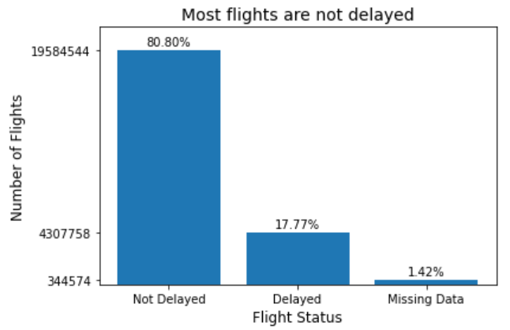
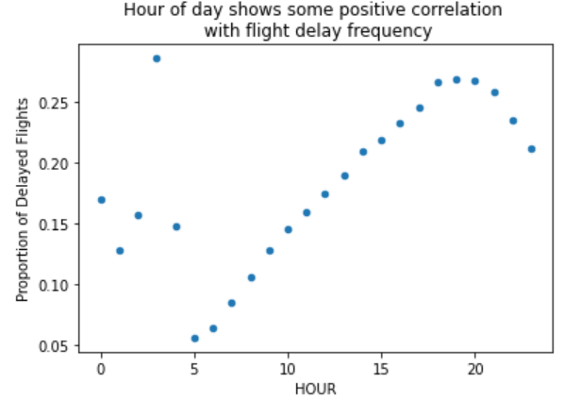
EDA: FLIGHTS
Notes:
Note: graphs cover 2015-2018 flight data only
[JEFF]
For our EDA we began by looking at our label (DEL15) for flights from 2015 to 2018. We found an unbalanced dataset, with the majority of flights being on time. To address this issue we under sampled the majority class before running our models.
To address this, we are looking into oversampling the minority class, undersampling the majority class, or using weights. We haven’t made a final decision yet, but we’re looking into these options.
As well, we found that flights later in the day tend to be delayed more frequently. This could be the result of delay propagation, which is not surprising since delayed flight arrival is a common cause for delayed departure. Later we will talk about how we used this information to create a new feature.
—---
Target class is unbalanced
Flights later in the day tend to be more delayed
Flight delays tend to grow towards the end of the day

Slide 8
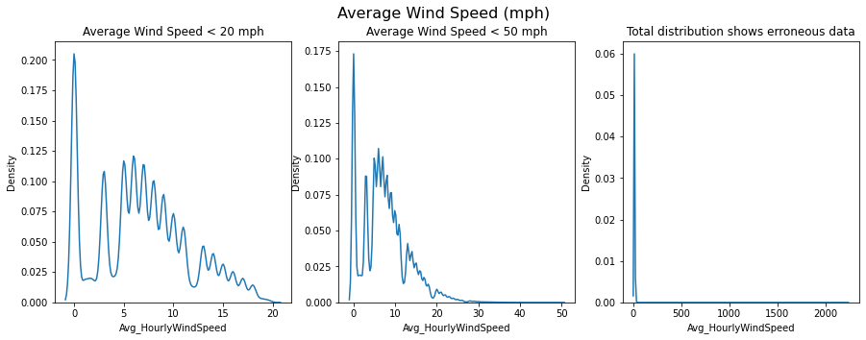
EDA: WEATHER
Notes:
[JEFF]
We looked at the distribution of our features.
Skewed
Transformations
Erroneous data (ex. Wind speeds >2000 mph do not exist)

Slide 9
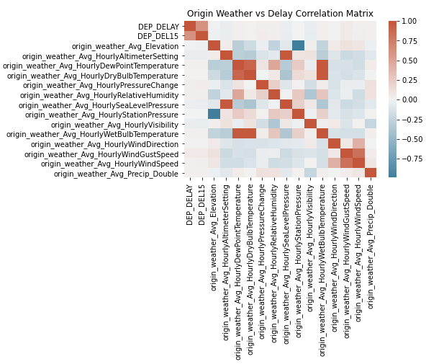
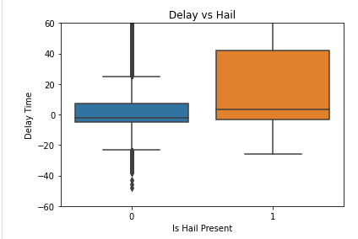
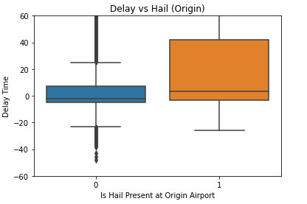
EDA: COMBINED DATASET
Notes:
[JEFF]
Jeff:
Once the weather and flight datasets were joined we began looking at correlations between delay and weather features, as seen in this correlation matrix. We were able to identify several weather features that are highly correlated with each other. This information was utilized when selecting features for our model. As you can see there is no strong correlation between numeric weather variables and our label (Dep_DEL15)
We also began looking at our binary weather variables versus delay time and were able to see several trends. One of these as can be seen on the right is with “the presence of hail at the origin airport”, which is not surprising. Again this information was utilizing when selecting our features.

Slide 10
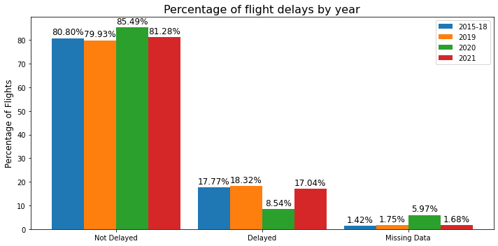
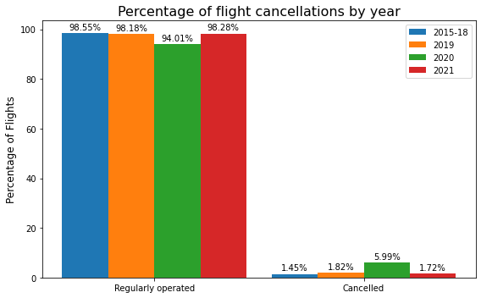
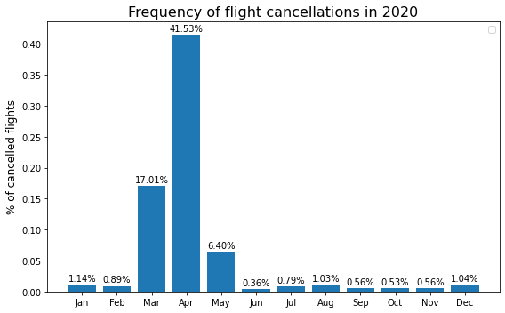
EDA: 2020 & 2021 DATA
Notes:
[JEFF]
Finally we wanted to see if there were any major differences in delays and cancellations in the years 2020 and 2021
The delay versus non-delay imbalance was consistent across years, except for 2020 which showed less frequent delays and more cancellations, especially in the months of March, April and May.
Because we are not predicting cancellations, our intuition was that our model will deliver consistent results for 2020 as long as the causes of delay have not significantly changed, which we validated.

Slide 11
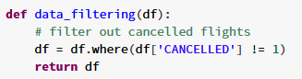
DATA PIPELINE
Ingest &
Join Data
Data
Cleaning
OHE & Normalizing
Write to
Parquet
Train - Test
Split
Address Imbalance
Model
Data Cleaning
Filter out cancelled flights
Filter out information unknown 2 hrs before flight (delay performance, diversion info)
Null handling
One-hot encoded categorical data
Normalize numerical data with min-max scaler
Train/Test split
Train: 2015-2018
Test: 2019-2021
Address Imbalance
Undersampled the majority class (no delays)
Notes:
[JENNY]
We prepared our data for modeling by cleaning and adding transformations, which included filtering, normalizing, and one-hot encoding.
We used the same pipeline to consistently process train and test datasets
We use the 2015-2018 data as our training set, and 2019-2021 as test sets
For the testing set, since we have three years of data, we separated our test data by year
We ultimately chose the model with the best performance on the 2019 test set
Significant amount of data in our test set – we separated by year because of the uniqueness of each year (3 test sets instead of 1)
To address class imbalance, we undersample the majority class in our training set, which Jeff mentioned earlier.

Slide 12
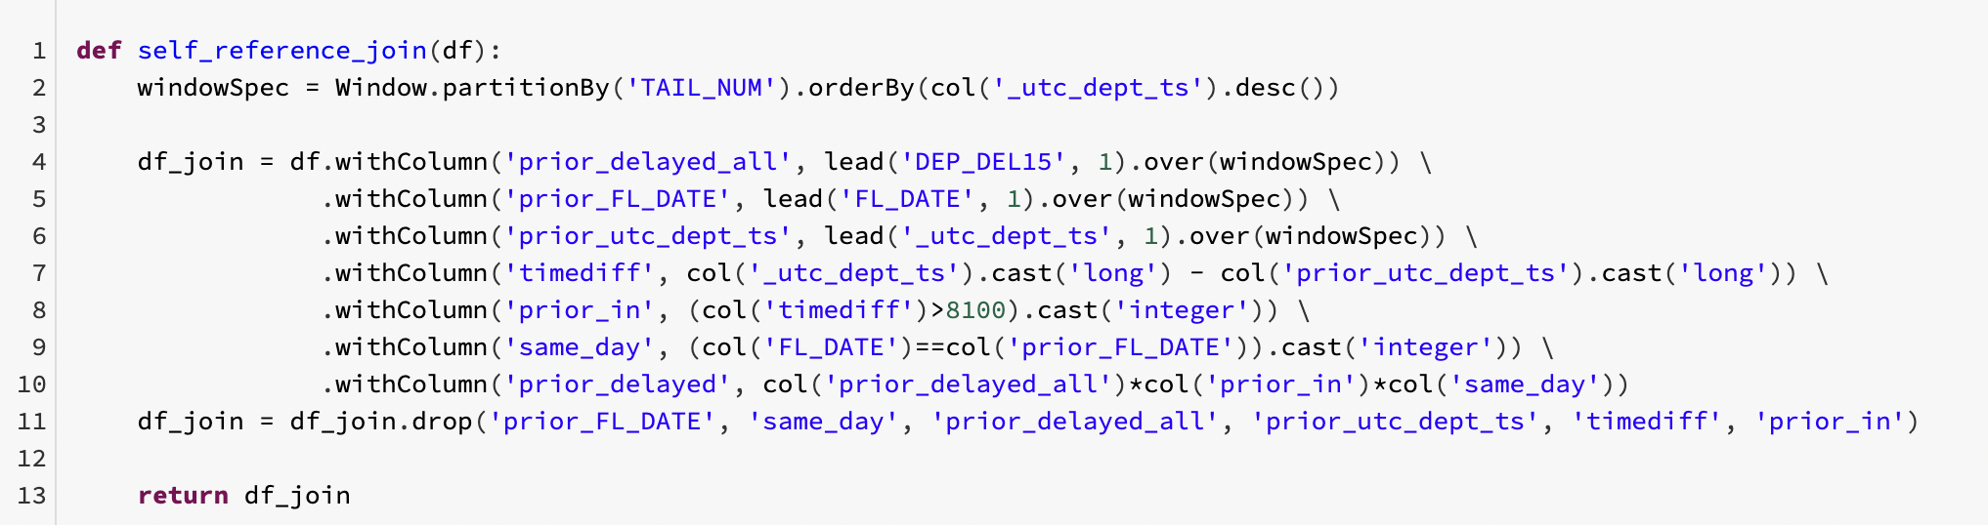
FEATURE ENGINEERING
Holidays
New columns to track if flight date is within 5 days of a US holiday
Delay Frequency By Airline
Grouped airlines by frequency of delays (low < 17% delayed, medium, high >20% delayed)
Incoming Aircraft Delay
Joined dataset with itself using tail number to find delay of previous flight
Previous flight must be 2-24 hours before the current flight
Notes:
[JENNY]
We engineered three new features for our model. First is the holiday feature which indicates if a flight falls within 5 days of a US holiday
We initially used both the holiday indicator and the holiday window as two separate features but ended up dropping the holiday indicator since these two features were highly correlated.
Then we categorized airlines by their delay frequency into three groups: low, medium, and high.
Finally, we added an indicator for whether or not the incoming flight is delayed based on knowledge known at least 2 hours before current flight time.
We did this by sorting our dataset in chronological order for each tail number, which allowed us to easily find the previous flight. Then we pulled the previous flight’s delay indicator as long as this was known at least 2 hours before the current flight time.
And I will pass to Ram to discuss our best model results.

Slide 13
CLASSIFICATION MODELS
Baseline Model
Logistic Regression
Random Forest Classifier
Predict a single class
Predict Majority Class:
F_{β} = 0.70
Predict Minority Class:
F_{β} = 0.04
Final Model:
F_{β} = 0.80
Cross-Validated Model:
F_{β} = 0.80
Optimized for 3 hyperparameters:
L1 Regularization Term
L2 Regularization Term
Maximum Iterations
Basic Model:
F_{β} = 0.80
Depth = 20
NumTrees = 30
Optimized for 2 hyperparameters:
Max Depth
No. of Trees
Notes:
[RAM]
We trained two different models - logistic regression and random forest classifier. The first box for baseline lists the metrics if our model predicted all positives or negatives.
We used block year cross validation and F_beta is primary evaluation metric. Choosing F_Beta was a little bit of challenge as the CV Custom e
Choice of F_Beta required computing a lot from scratch
Model needs to be balanced, but the business consequences of a False Positive can be worse than those of a False Negative ⇒ Chose to give higher importance to precision than recall ⇒ F_beta (beta = 0.5)
Evaluating multiple cross validation strategies
Leaning towards a blocked CV approach, mostly to avoid data leakage when the same portion of the data is used both for training and test - more to come in next slide
Considering various classification models, including Logistic Regression (as a baseline), but most likely leaning towards Random Forest or some other non-linear model due to the non linear nature of the data
Obviously, doing work on regularization and model simplification to improve performance on generalizability
One important challenge that we are still working through is how to handle imbalance

Slide 14
CLASSIFICATION MODEL
Evaluation Metrics
Cross Validation
Models Under Consideration
CustomCrossValidation for Time Series
Block CV over Tiered CV
Logistic Regression
Random Forests
+ Regularization
+ Dimensionality Reduction
+ Handling imbalance
(1+β²) · (Precision · Recall)
F_{β} =
(β² · Precision + Recall)
β = 0.5
Notes:
[DANTE]
Model needs to be balanced, but the business consequences of a False Positive can be worse than those of a False Negative ⇒ Chose to give higher importance to precision than recall ⇒ F_beta (beta = 0.5)
Evaluating multiple cross validation strategies
Leaning towards a blocked CV approach, mostly to avoid data leakage when the same portion of the data is used both for training and test - more to come in next slide
Considering various classification models, including Logistic Regression (as a baseline), but most likely leaning towards Random Forest or some other non-linear model due to the non linear nature of the data
Obviously, doing work on regularization and model simplification to improve performance on generalizability
One important challenge that we are still working through is how to handle imbalance

Slide 15
J
F
M
A
M
J
J
A
S
O
N
D
2015
T1
T1
T1
T1
T1
T1
T1
T1
T1
T1
T1
T1
2016
V1
V1
V1
V1
V1
V1
V1
V1
V1
V1
V1
V1
2017
T2
T2
T2
T2
T2
T2
T2
T2
T2
T2
T2
T2
2018
V2
V2
V2
V2
V2
V2
V2
V2
V2
V2
V2
V2
Notes:
[DANTE]
Current approach ⇒ 2 folds, 2 years each, 1 train, 1 test

Slide 16
J
F
M
A
M
J
J
A
S
O
N
D
2015
T1
T1
T1
T2
T2
T2
T3
T3
T3
T4
T4
T4
2016
V1
V1
V1
V2
V2
V2
V3
V3
V3
V4
V4
V4
2017
T5
T5
T5
T6
T6
T6
T7
T7
T7
T8
T8
T8
2018
V5
V5
V5
V6
V6
V6
V7
V7
V7
V8
V8
V8
Notes:
[DANTE]
One way to increase the number of folds is to work on quarters or semesters, but we want to take into accoun seasonality (as this model does)
This is still using one year entirely for training and one entirely for testing - Is it a limitation?

Slide 17
J
F
M
A
M
J
J
A
S
O
N
D
2015
T1
T1
T1
T7
T7
T7
T2
T2
T2
T8
T8
T8
2016
V1
V1
V1
T3
T3
T3
V2
V2
V2
T4
T4
T4
2017
T5
T5
T5
V3
V3
V3
T6
T6
T6
T4
T4
T4
2018
V5
V5
V5
V7
V7
V7
V6
V6
V6
V8
V8
V8
Notes:
[DANTE]
This approach would provide the most heterogeneous view of the data
If it gets too complicated, it could be done by semesters instead of quarters

Slide 18
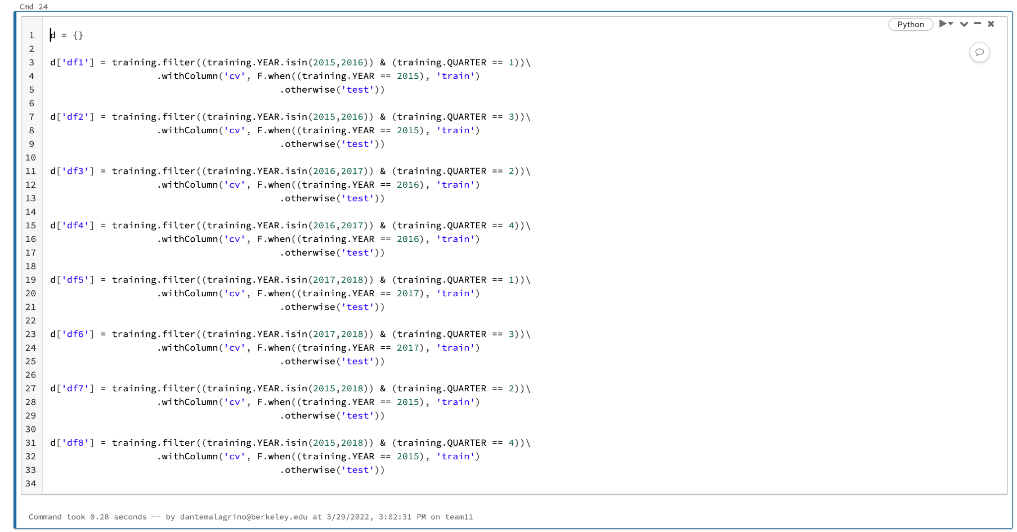

Slide 19
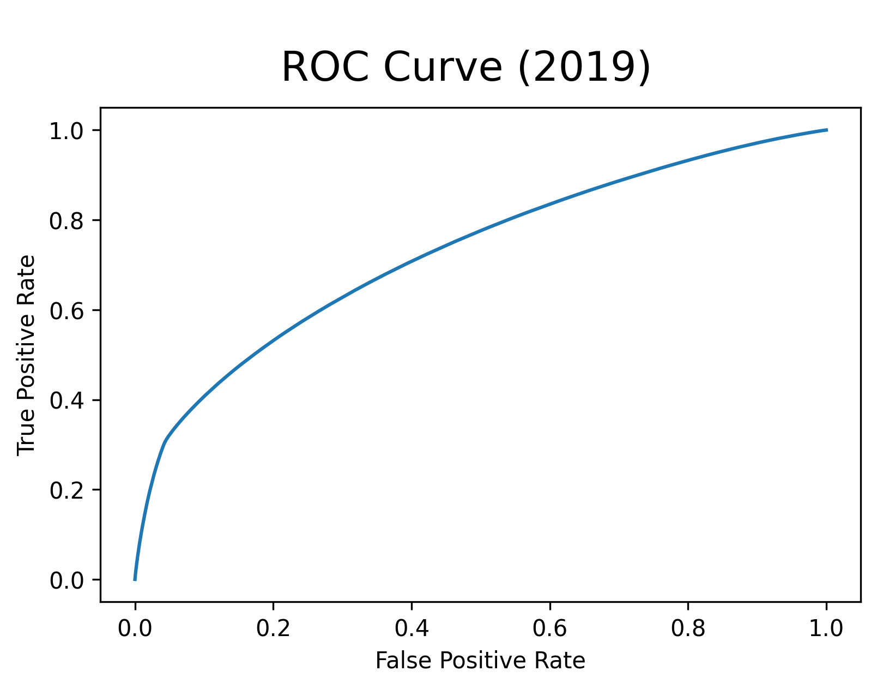
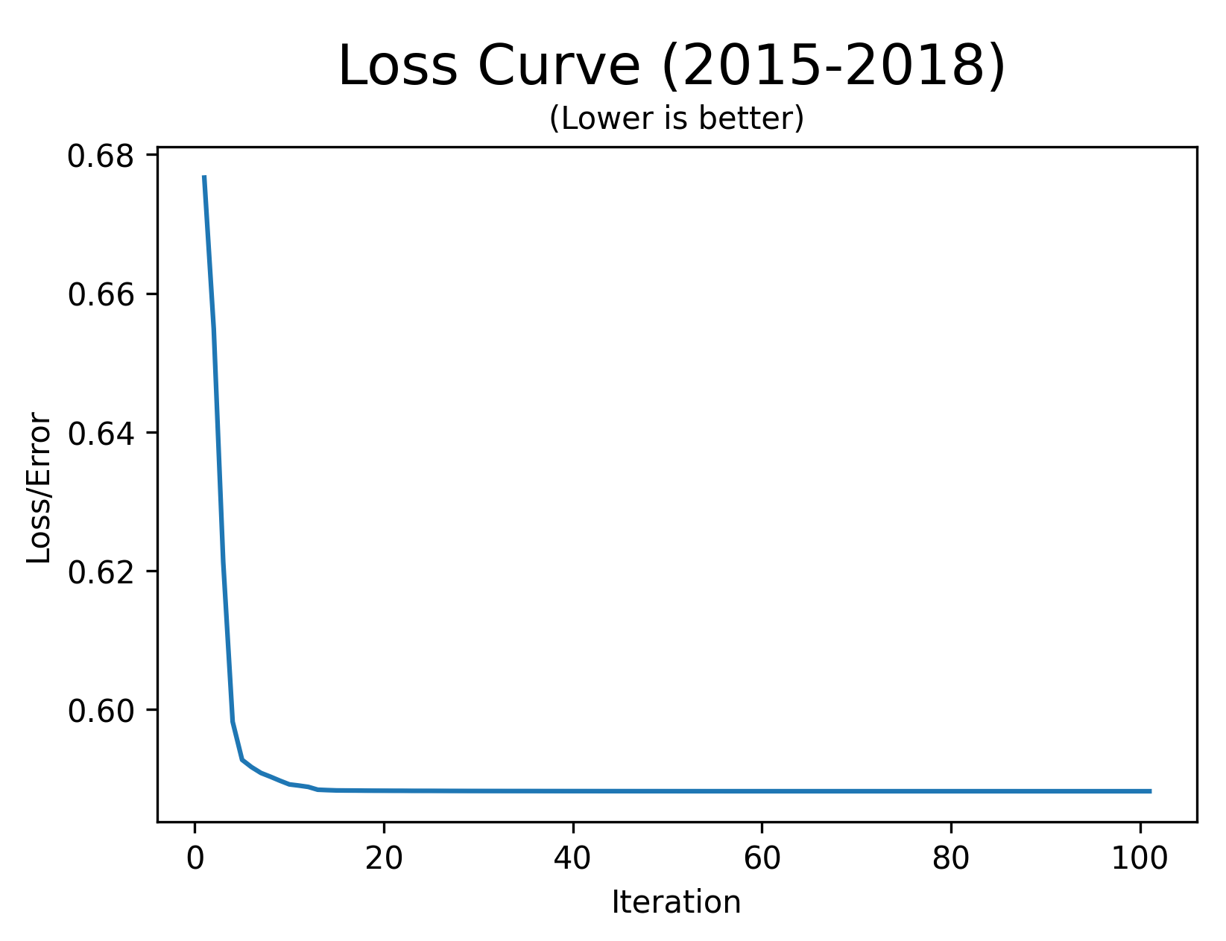
FINAL MODEL
Logistic Regression with params:
Regularizations - L1: 0 .01, L2: 0.01
Training Iterations: 100
CV Method: Block Years
Notes:
[RAM]
Our final, tuned logistic regression model used 0.01 for both L1 and L2 regularization. We used block years as our cross validation strategy. Train on 2015, validate on 2016; train on 2017; validate on 2018. Lastly we trained the model over 100 iterations.

Slide 20
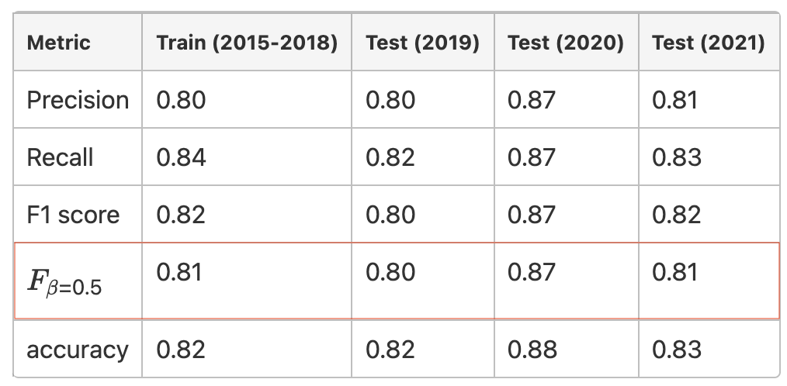
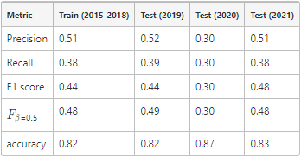
2019 - 2021 RESULTS
Weighted Average Metrics
Binary Metrics
Even with all the disruptions and delays caused by the pandemic in 2020 and 2021 the Logistic Regression model still performs well
The changes due to the pandemic don’t seem to have changed the cause of delays
Notes:
[RAM]
And here is how our model performed against the training dataset as well as the three test datasets. We have two sets of metrics. The first one is a weighted average of the metrics against the two classes while the second one is for just the positive class, where positive means flight is delayed 15+ minutes. Unfortunately, during our model training we were relying only on the weighted averages. So our team got mislead on how our models were doing. Next, Dante will go into learnings from this in more detail.

Slide 21
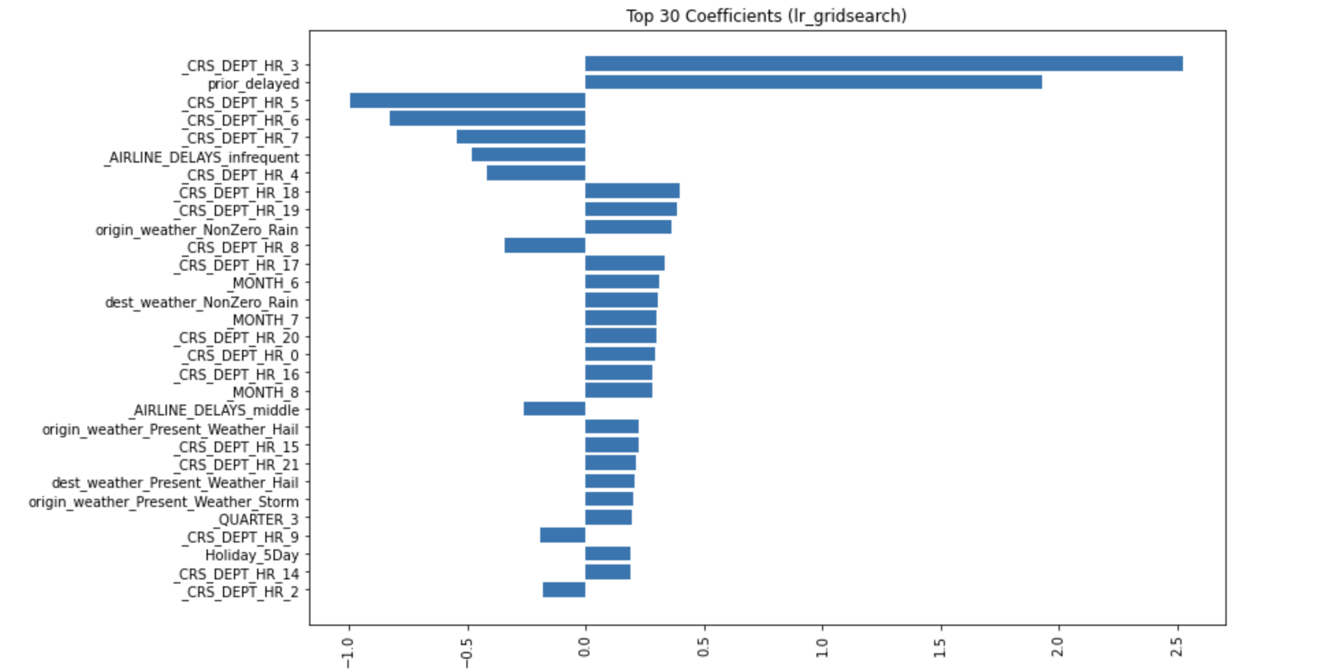
FINAL MODEL
Total no. of features: 76
Notes:
[RAM]
****

Slide 22
CHALLENGES
Ingesting data from new data sources (Flights, Weather, Aircrafts, Airlines,...)
Metric of choice for evaluation (F_{β}) and use of CustomCrossValidator()
Code infrastructure for flexible future enhancements
Notes:
[DANTE]
The biggest challenge we faced was importing and ingesting 450 GB. We learned that limiting the amount of data earlier is better. Limiting to weather stations near airports reduced the ingestion time from 5 hours to 17 minutes. New data also meant we had to redo the EDA, which took time away from modeling work.
Next challenge was one of scale while join the data. We grouped both flights and weather data into 1-hour windows and filtered the weather stations, giving us a 25 minutes join time.
While doing this we inadvertently introduced data leakage which we had to fix.
[from guidelines] Performance & Scalability concerns, pipeline errors, debugging experiences
Importing about 450 GB of weather data for 7 years and manipulating it was very costly and time consuming, compounded by the inadvertent rookie mistakes. In the process, we learnt that reducing the data work much earlier in the process helps. Limiting the number of weather stations to those near airports of interest even before the ingestion process helped. We reduced the ingestion time from 5 hours to under 25 minutes.
Another challenge we had was that, by default, Spark was creating multiple 1 mb parquet files that lead to large read times. Repartitioning with year as partition key helped.
Spark's data type inference logic gave us a lot of grief. We ended up ingesting all fields as strings and applied our own conversion for the fields we need.
Grouping flights and weather into 24 windows per day (1 for the hour of the day), in addition to the reduced weather stations to look at, helped us achieve join time of about 25 minutes. The logic also includes a simple aggregation of weather data from potentially multiple readings within the hour.
Identifying potential data leakage issues with current hourly weather aggregation method
That was not easy to achieve. We had quite a few challenges. For example, we had to work with 450 GB of data, which presented challenges for importing and ingesting. We had to do a couple of iterations because of rookie mistakes.
The earlier you limit the amount of data you work with, the better.
We removed weather stations early on, which helped us implement the join in 25 minutes.

Slide 23
PROJECT LEADERBOARD &
GAP ANALYSIS
Top-performing teams: Friends Across Ocean and Team Super Mario
Additional Methods Tried: XGBoost, PCA, expanded hyperparameter set for Random Forest
Additional Methods from other teams: PageRank, SMOTE
Notes:
[DANTE]
Based on what we have done so far, we have a plan for the next few weeks. With that we would like to conclude and open it up for question and answers.

Slide 24
LIMITATIONS & FUTURE WORK
More error analysis to inform next iteration of modeling
Additional feature engineering and implement dimensionality reduction
Derive values to replace nulls rather than dropping
Address outliers by removing or replacing data
Implement graph-based algorithms (ex. Page Rank)
Integrate tail number data
Notes:
[DANTE]
With that we would like to conclude and open it up for question and answers.

Slide 25
THANK YOU
Notes:
[DANTE]

Slide 26
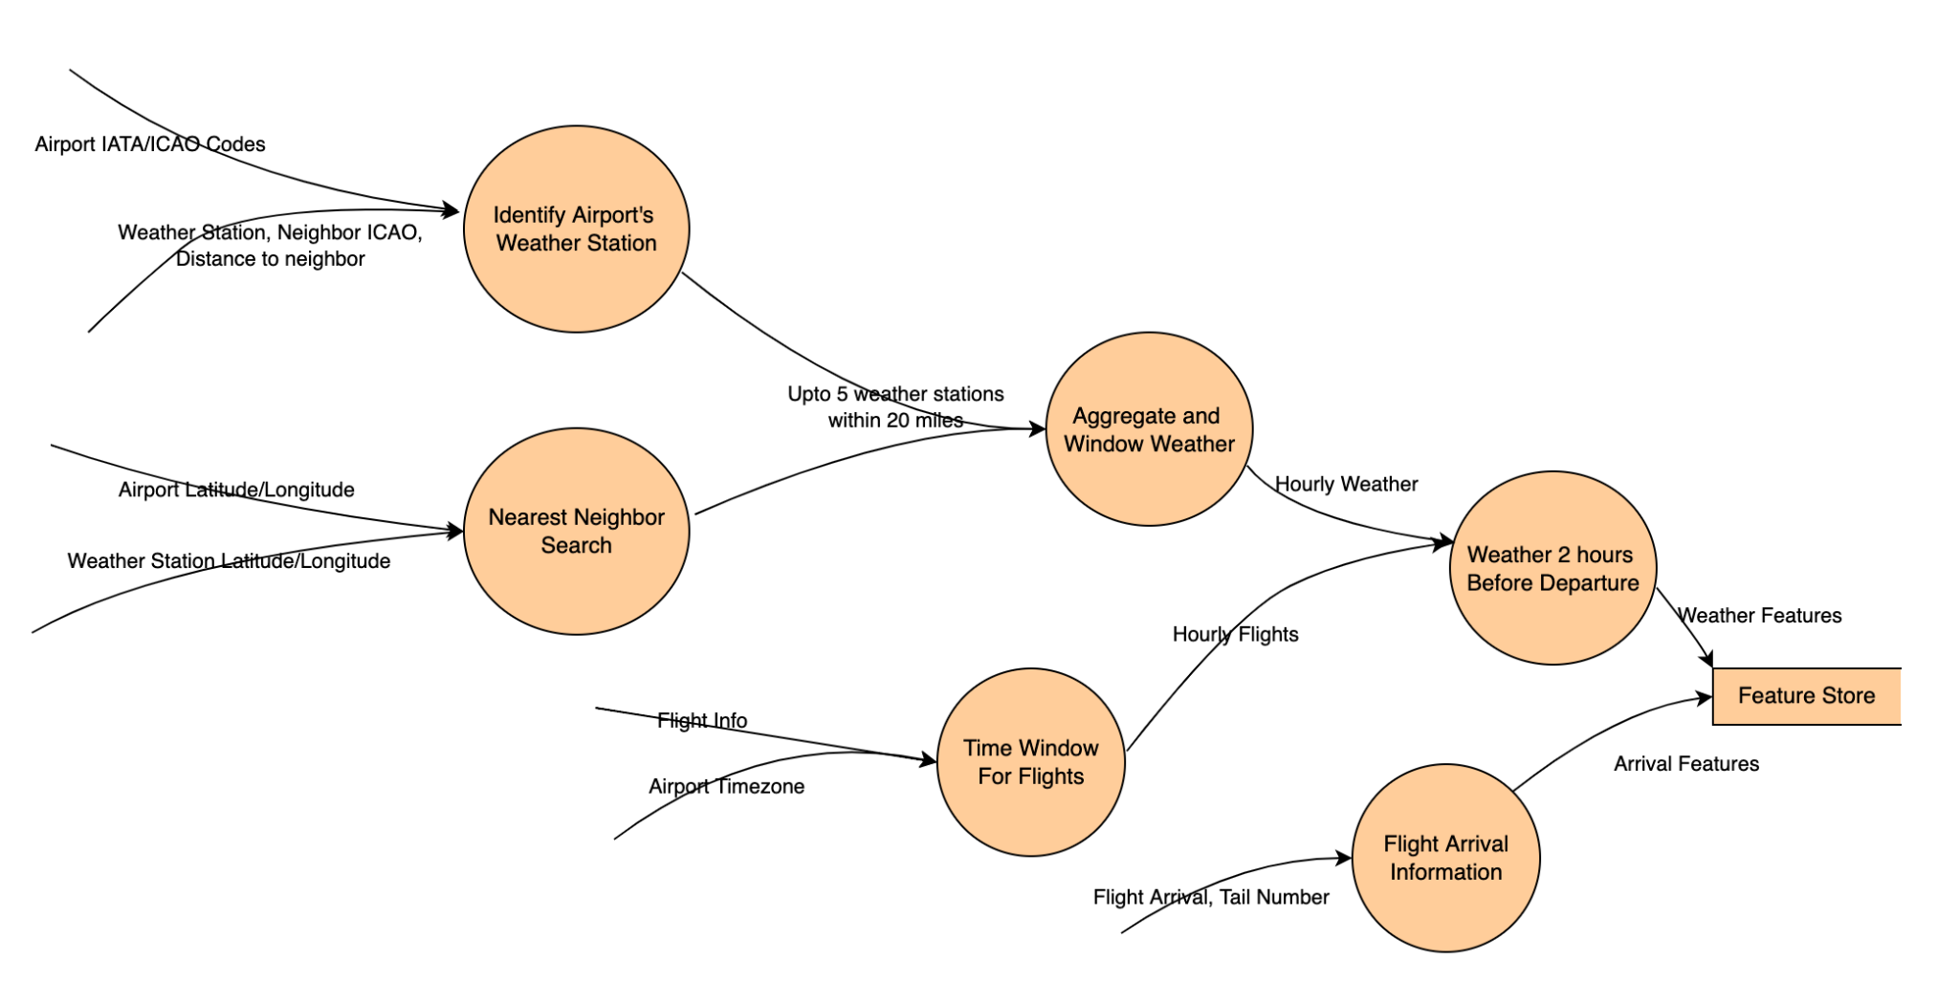
Datasets
Notes:
[RAM]
This graphic illustrates how we will be joining multiple datasets. Our combined dataset has over 30 million flights between about 370 airports in the United States and 40 million weather observations from 700 weather stations.
Key points (for any questions):
Addressing Scale
12,000 weather stations to 700 weather stations near 372 airports.
630 million observations to about 40 million observations.
31 million flights between 372 airports
Joins
IATA <-> ICAO, IANA for TZ.
Ball Tree based KNN using latitude and longitude. Upto 5 weather stations within a 20 mile radius.
Date + hour of day as partition key.

